Slide 1

HOTEL RSERVATION DATASET

Slide 2
About me
I have completed my B-tech in year 2024 at GITAM university, Hyderabad
I want to learn Data Science because it is a fascinating field where we can understand and make decision based on the information. It allows you to uncover patterns, make predictions, and solve problems effectively.
I don’t have any experience

Slide 3
Objective and overview of the features of the project
Objective : To analyze the data, uncover patterns, and build a predictive model.
The objective of this analysis is to predict the booking status (whether a hotel booking will be canceled or not) based on various customer and booking-related features.
Identify key factors influencing the booking_status
Dataset overview:
The dataset contains 36,275 rows and 19 columns. The dataset includes various features like type of meal , room type , market segment type
The dependent variable is booking_status and all remaining columns are independent variables
The dataset contains hotel reservation records, including details about customer demographics, booking preferences, and historical behaviors.
Data is analyzed to identify trends and build predictive models

Slide 4
Exploratory Data Analysis:
Data Cleaning Steps:
Missing values were handled for numerical and categorical variables.
Hypothesis testing helped in selecting the most relevant variables.
Removed outliers in no_of_previous_cancellations, no_of_week_nights, no_of_weekend_nights
Converting the datatype of the columns which are object to numerical data type

Slide 5
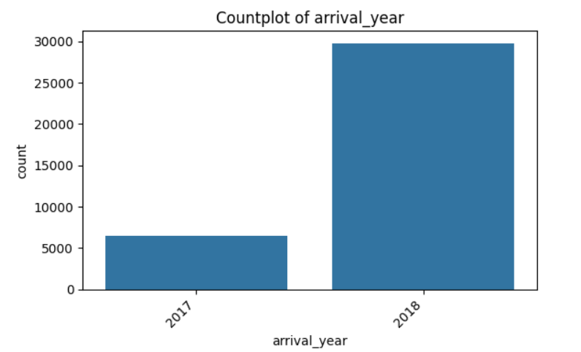
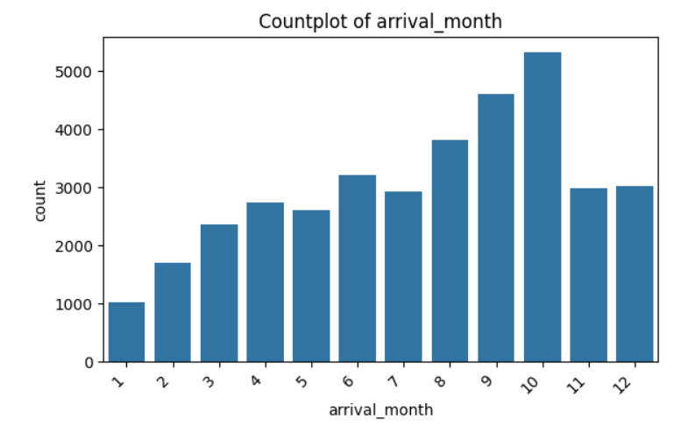
UNIVARIATE ANALYSIS

Slide 6
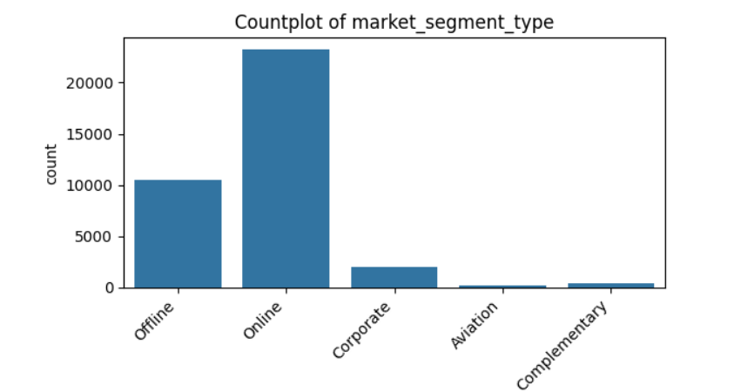
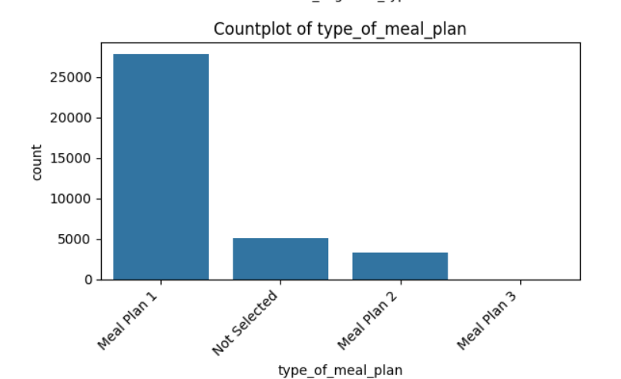

Slide 7
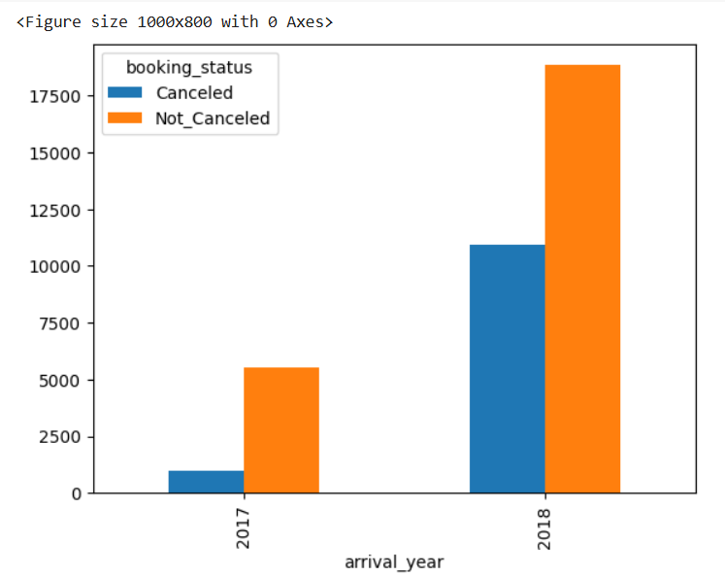
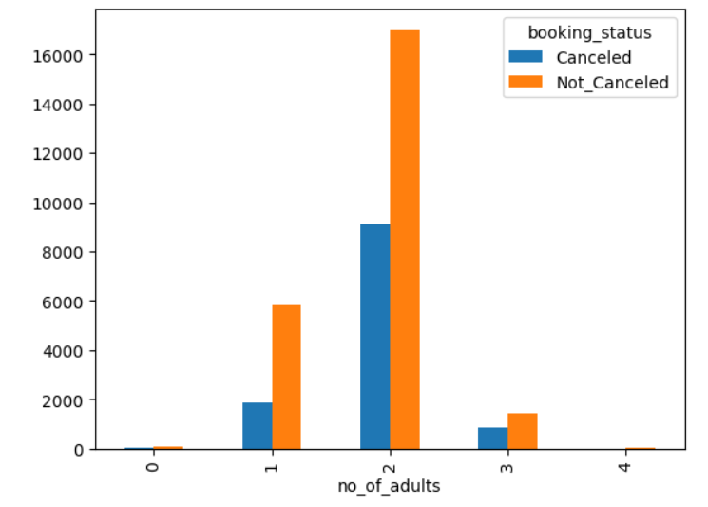
BIVARIATE ANALYSIS

Slide 8
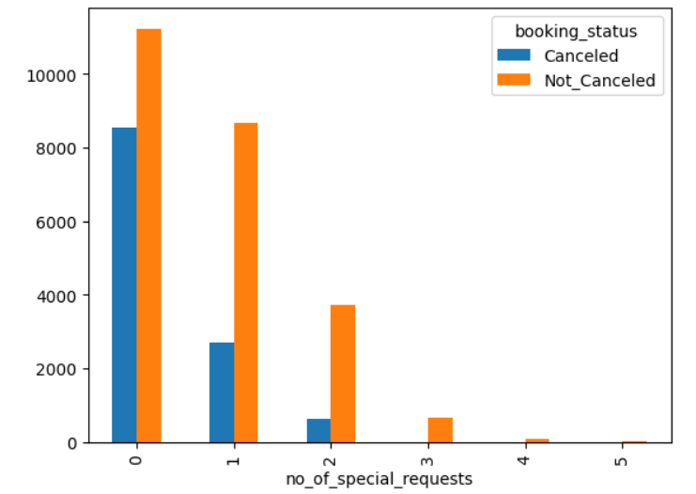
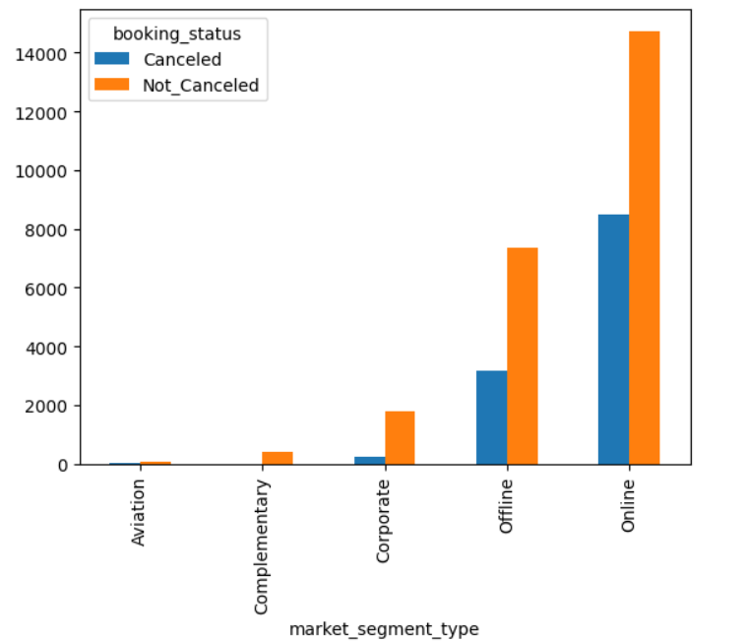

Slide 9
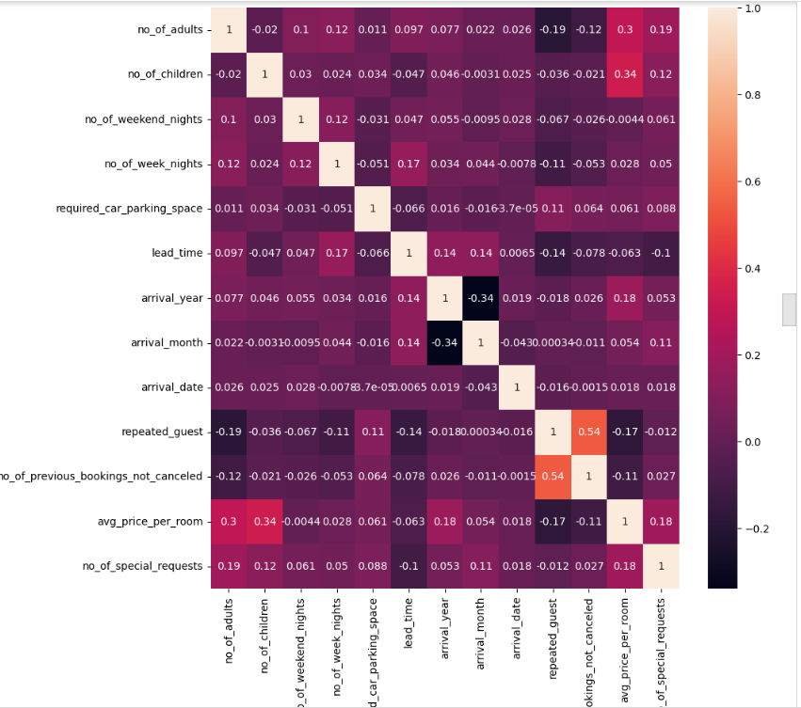

Slide 10
ENCODING TECHNIQUES
Since machine learning models and deep learning model works with numerical data, we used encoding techniques to convert categorical variables into numerical form.
In this project I have used label encoding for the column typeofmeal , roomtype , market segment type
I have used one hot encoding for the column for the column booking_status
Scaled numerical features for better model performance

Slide 11
PREDICTIVE MODELING
Models used: Logistic Regression, Decision Tree, Random Forest , GBM classifier and ANN model
Feature selection via hypothesis testing significantly improved performance.
Achieved 95% in training data and 85% in testing data in all ML models.
Achieved 87% both in training and testing using ANN model
Used accuracy, precision and recall to evaluate models.
Model helps predict booking_status probability.
Further validation needed to check for potential overfitting.

Slide 12
Conclusion
The hotel reservation dataset provides valuable insights into customer booking behavior and the factors influencing booking cancellations
By analyzing features such as lead time, room type, previous cancellations, special requests, and market segment type, hotels can better predict the likelihood of a cancellation.
Understanding booking patterns can help hotels: ✔ Reduce revenue loss by implementing dynamic pricing and overbooking strategies. ✔ Improve customer retention by identifying repeated guests and offering personalized experiences. ✔ Optimize resource allocation by forecasting demand based on seasonality and booking sources.

Slide 13
Experience
Hypothesis testing helped refine feature selection.
Handling data preprocessing and outliers was crucial.
Understanding hotel classification data helped in making business recommendations.

Slide 14
Q&A

Slide 15

THANK YOU

